Slide 1

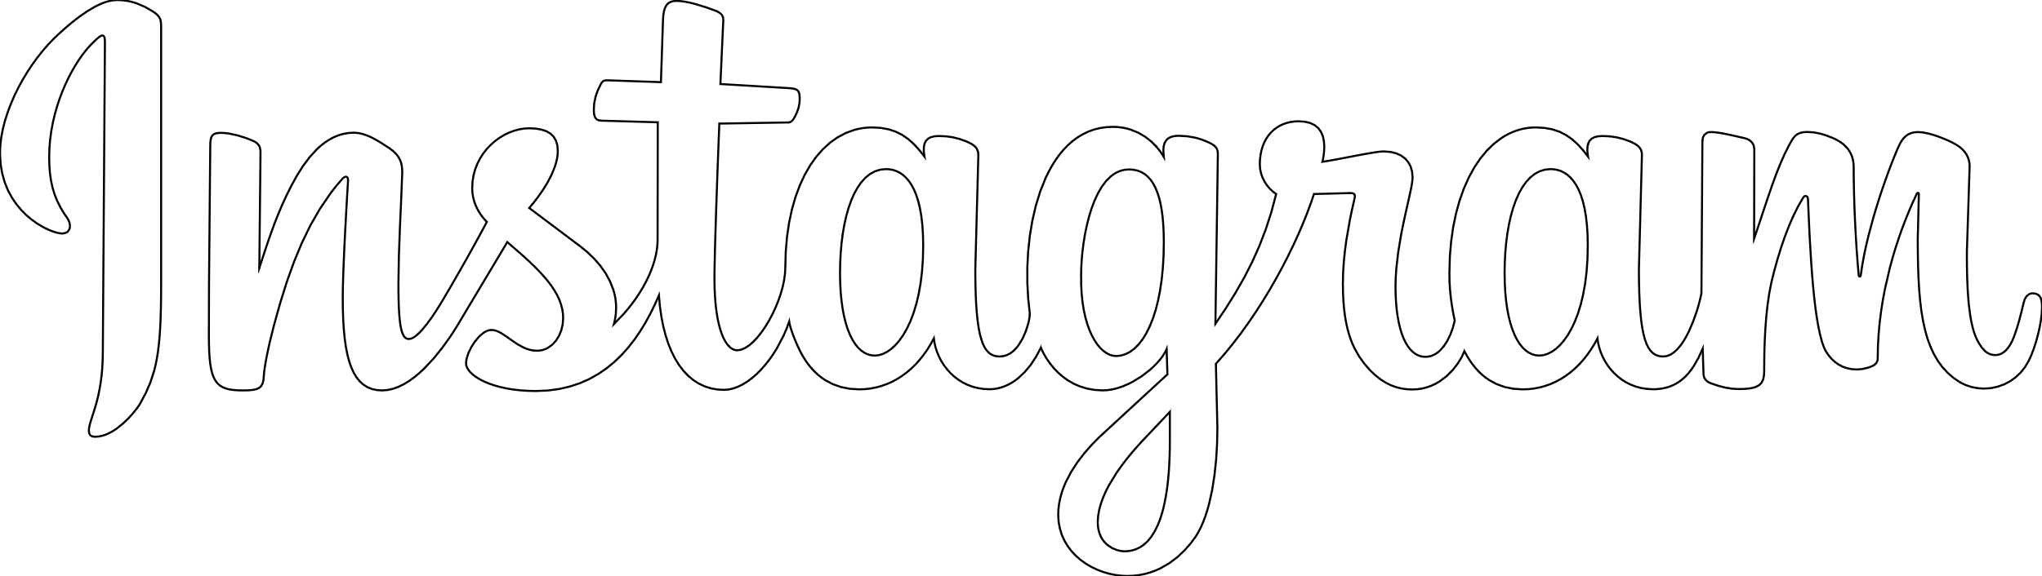


Exploring
#invisibledisability on
Challenging health messages
Presented by Stephanie Mantilla
Twitter @steph__mantilla
Instagram @steph__mantilla
www.thevisibilitymovement.com
Notes:
Slide 1 – Introduction

Slide 2

Defining invisible disability
An invisible disability is any ongoing health condition, illness and/or impairment that isn’t immediately visually observable in the majority of a person’s everyday life.
Notes:
Slide 2 – Definition

Slide 3
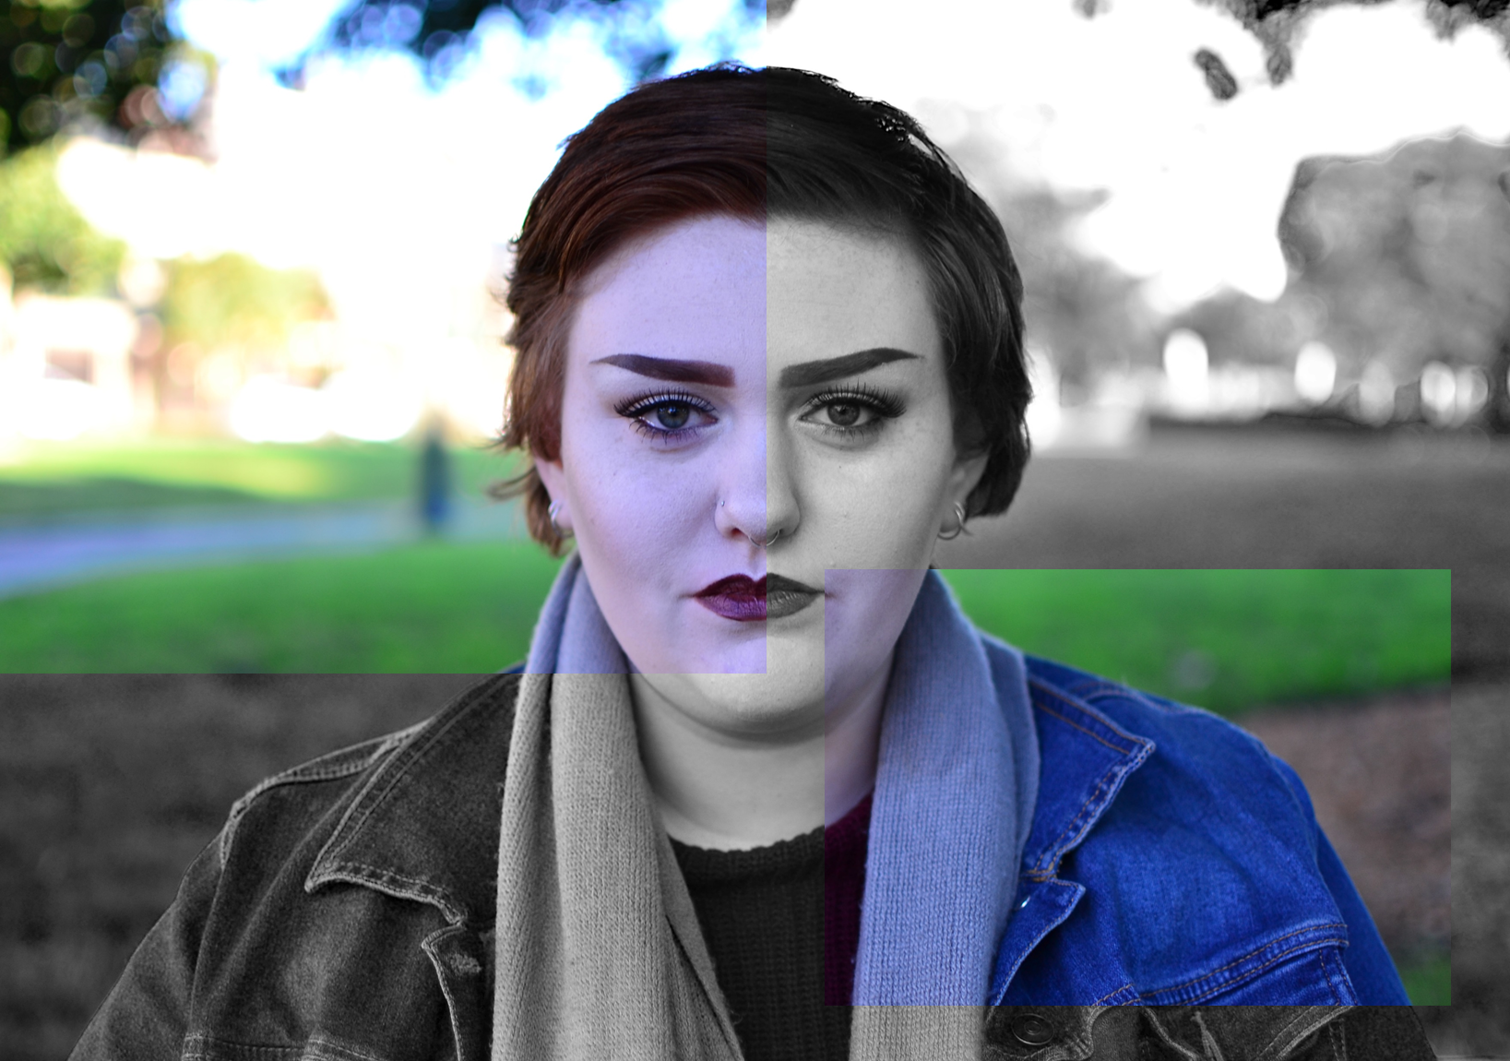
The invisible disability
identity & its ongoing
struggle for legitimacy
Notes:
Slide 3– Context – identity validation

Slide 4

Causes of the
invisible disability identity’s
“BUT YOU DON’T LOOK DISABLED.”
struggle for legitimacy
Difficulty to define invisible disability
Disability invisibility causing social invisibility
Medical denial
“YOU’RE JUST BEING LAZY.”
“YOU LOOK FINE.”
Notes:
Slide 4 – Causes

Slide 5
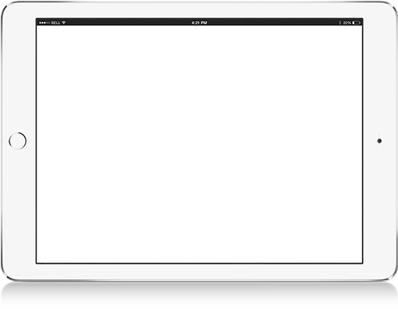
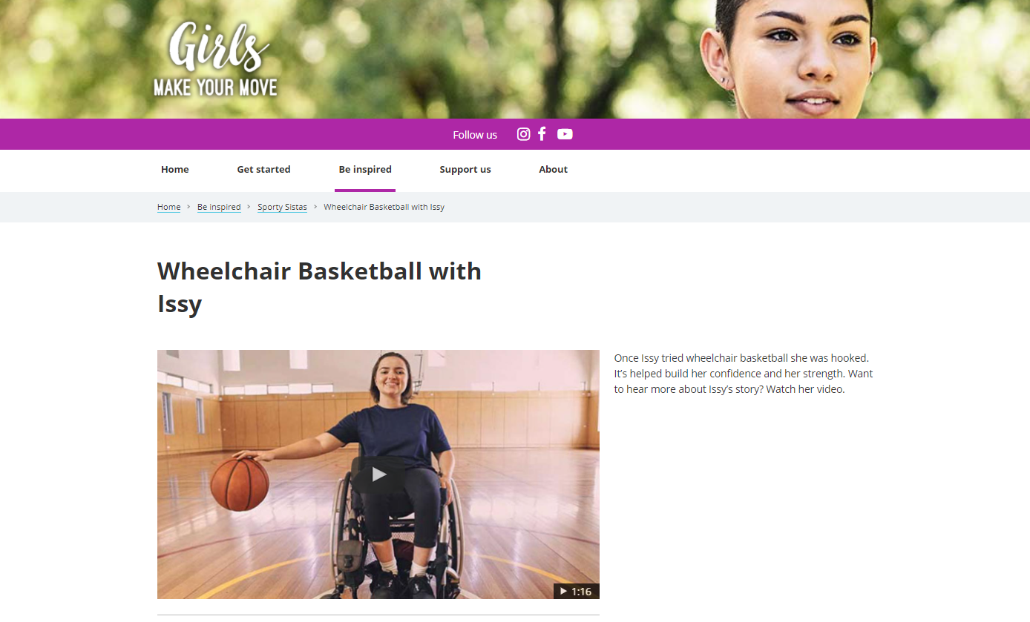
Issues with
disability representation in
health communications
In health communications people with disability often are largely excluded from representation, or:
People with visible disability are represented in tokenistic ways
People with invisible disability are represented as the opposite of healthy and used in fear appeals
Notes:
Slide 5 – Health communications

Slide 6
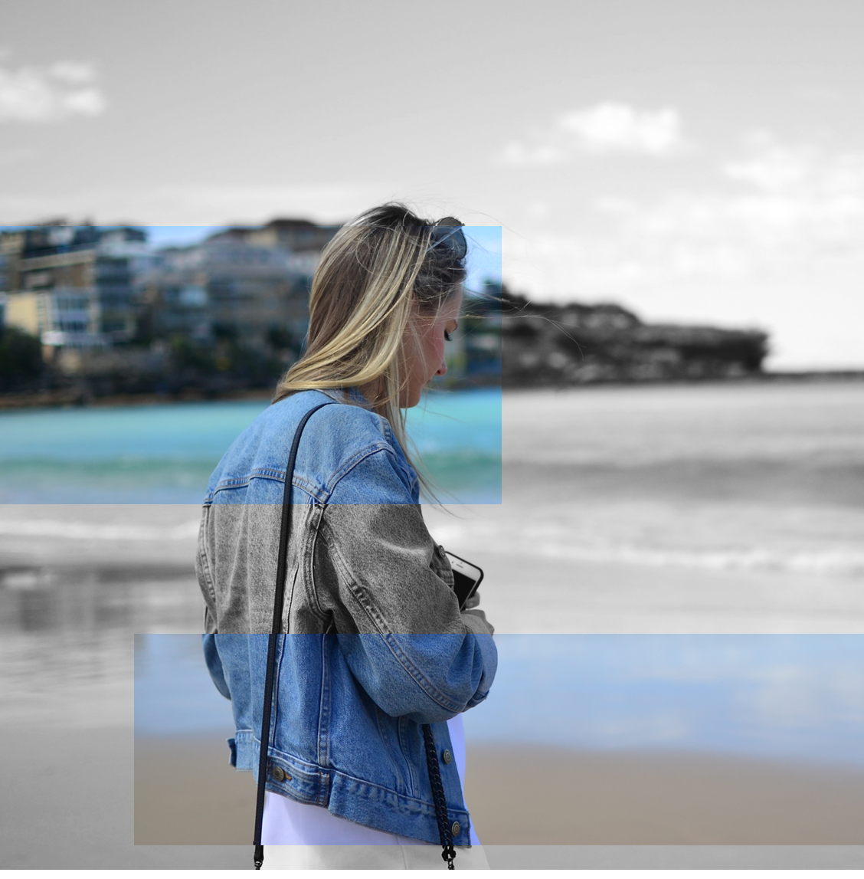
Research aims
How the #invisibledisability tag functions
If it could have a role in helping represent the invisible disability identity in a more inclusive way in future health campaign or health communications
Notes:
Slide 6 – Aims

Slide 7
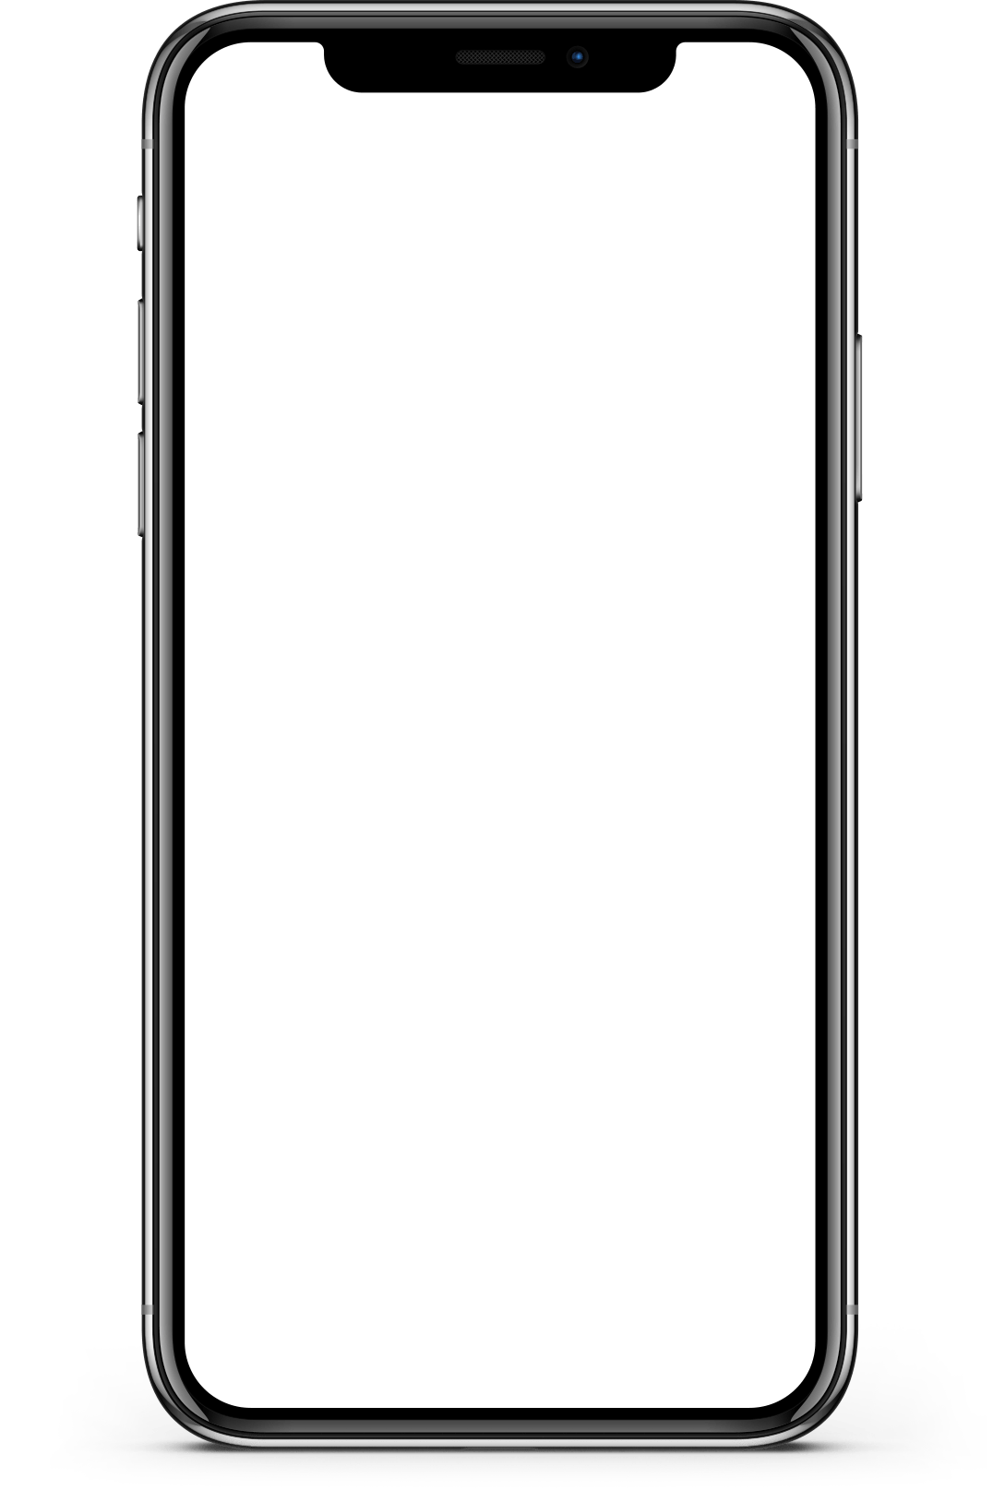
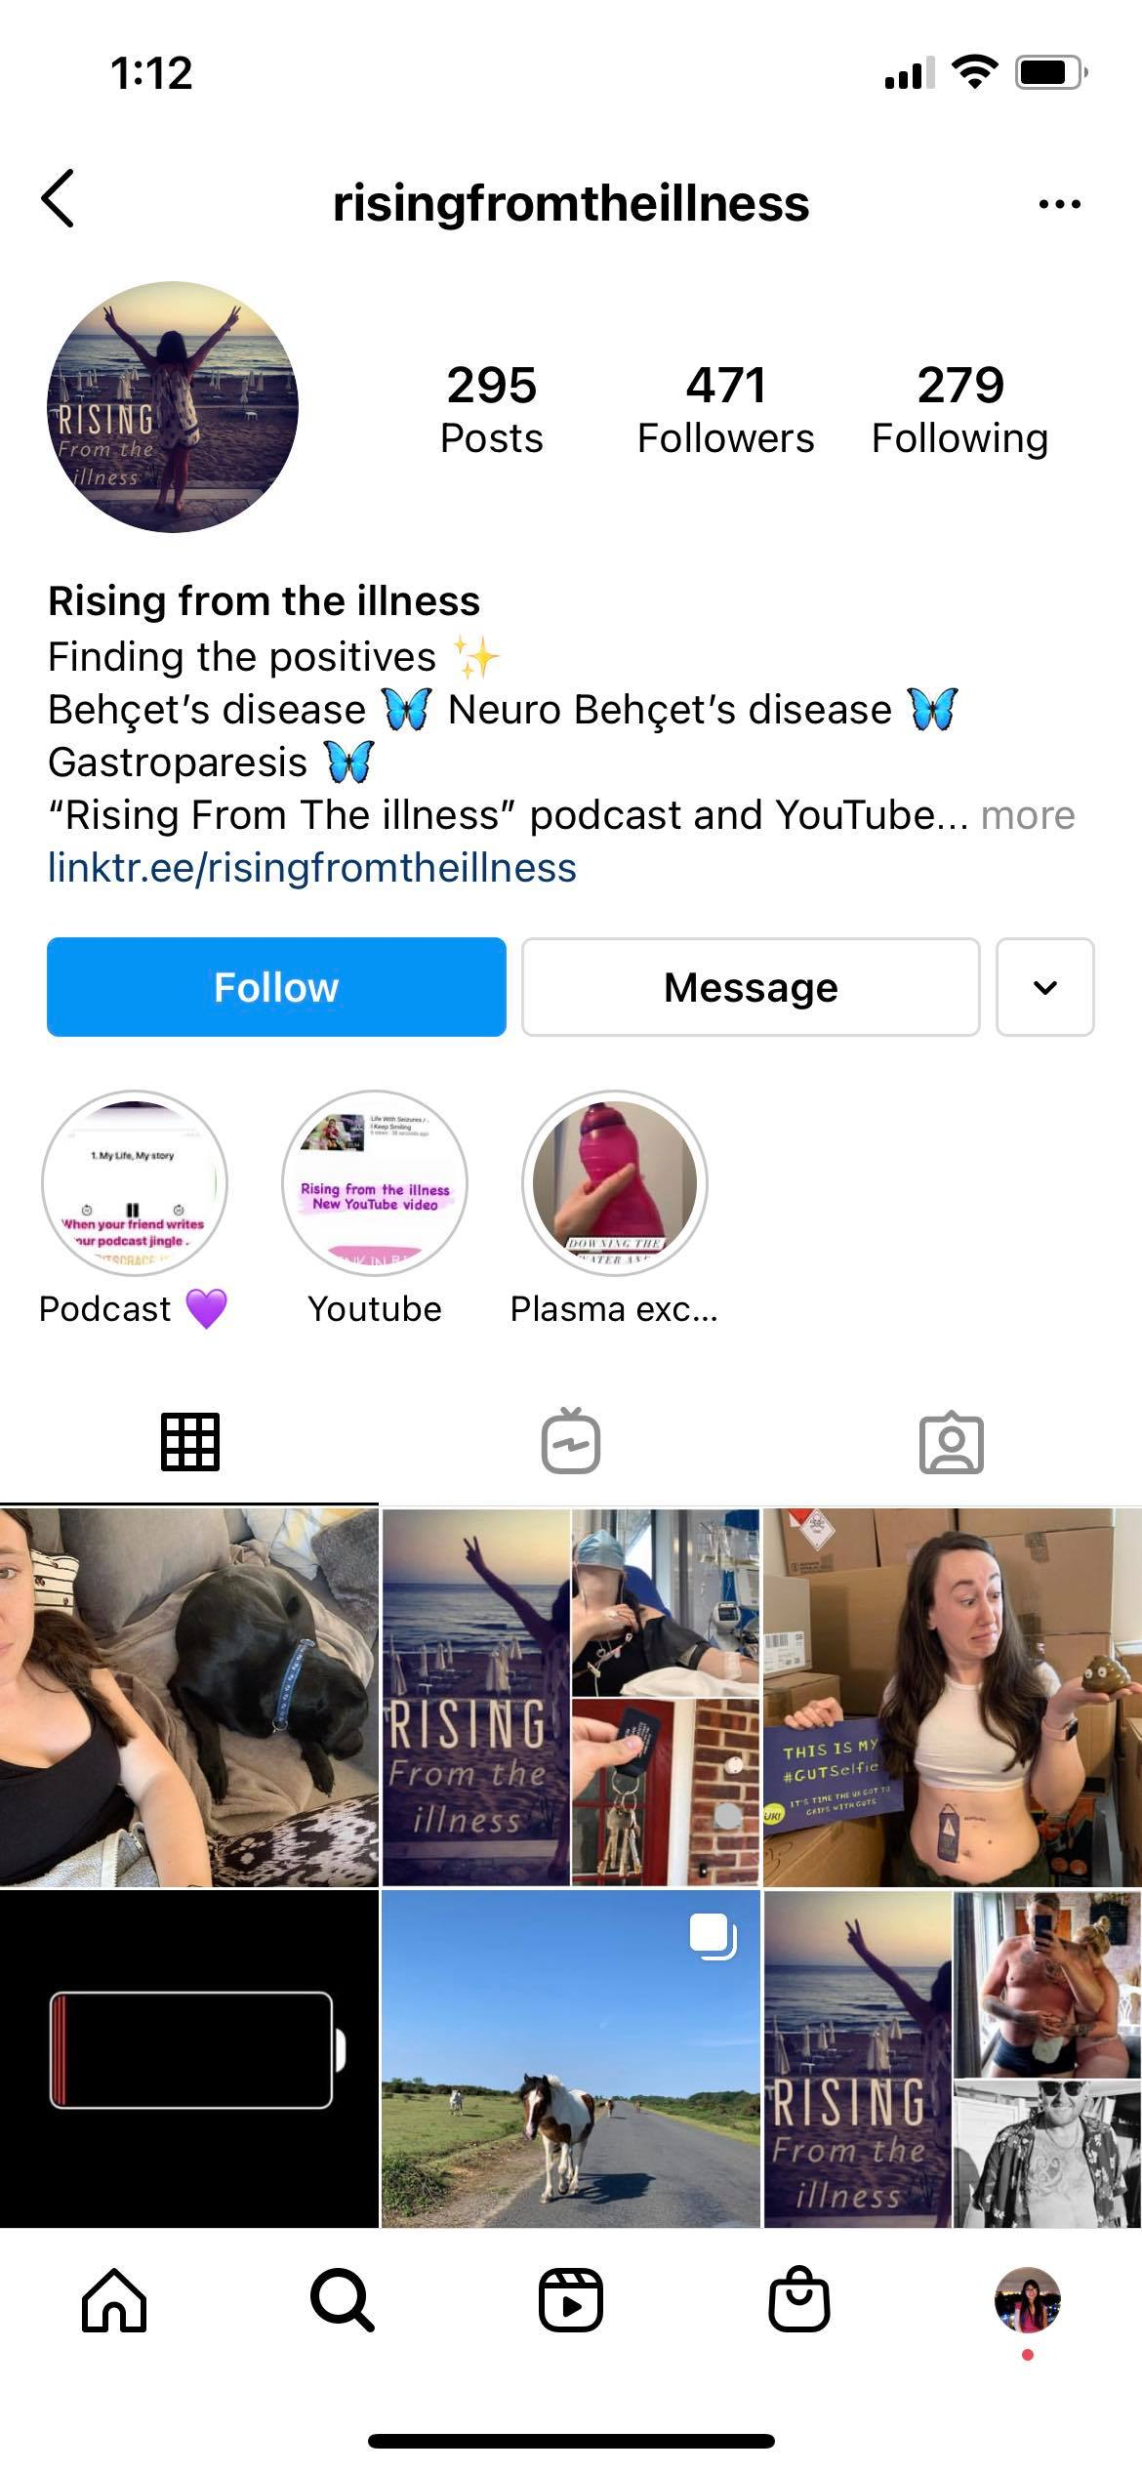
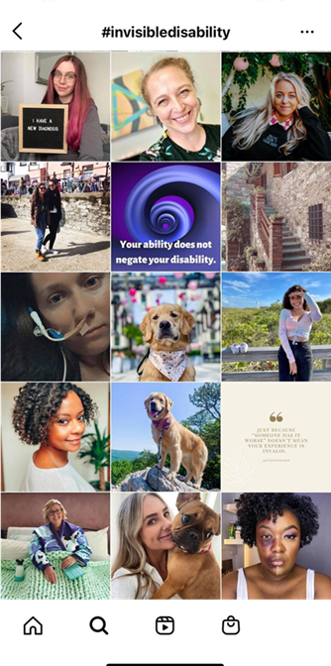
METHOD
Examining Instagram posts that used #invisibledisability
posted on 13th February, 2021
Inspired by Leaver and Highfield’s (2018, pp. 33-36) method for collecting Instagram images.
Notes:
Slide 7 – Method
The method that I used was inspired by Leaver and Highfield’s (2018) method for collecting Instagram images. It involved examining all the Instagram posts that were uploaded on 13th February, 2021 that contained the #invisibledisability tag. The date was chosen at random and the study was repeated a few months later at another random date, however I haven’t included those results today.
When it came to data collection all the posts’ data was collected and placed in an Excel sheet and in an NVivo12 file. The data was then coded for common elements across those files.
There was a total of 229 posts of which I had to remove 5, as they weren’t in English. I also coded for commonalities across all the accounts that posted, as these accounts provided necessary context into understanding the way the #invisibledisability tag was being used.

Slide 8
Results
129 posts contained an #invisibledisability story
Notes:
Slide 8 – Results
Here what I mean by story, takes into account the nature of posting on Instagram and that some stories may be shared in a fragmented way or in the space of a line. So these stories wouldn’t fit into the more traditional structuralist understandings of narrative or what some narrative media theorists call “big stories.” So for this reason it was important that invisible disability stories also included “small stories” (Bamberg & Georgakopoulou, 2008, p. 381).

Slide 9
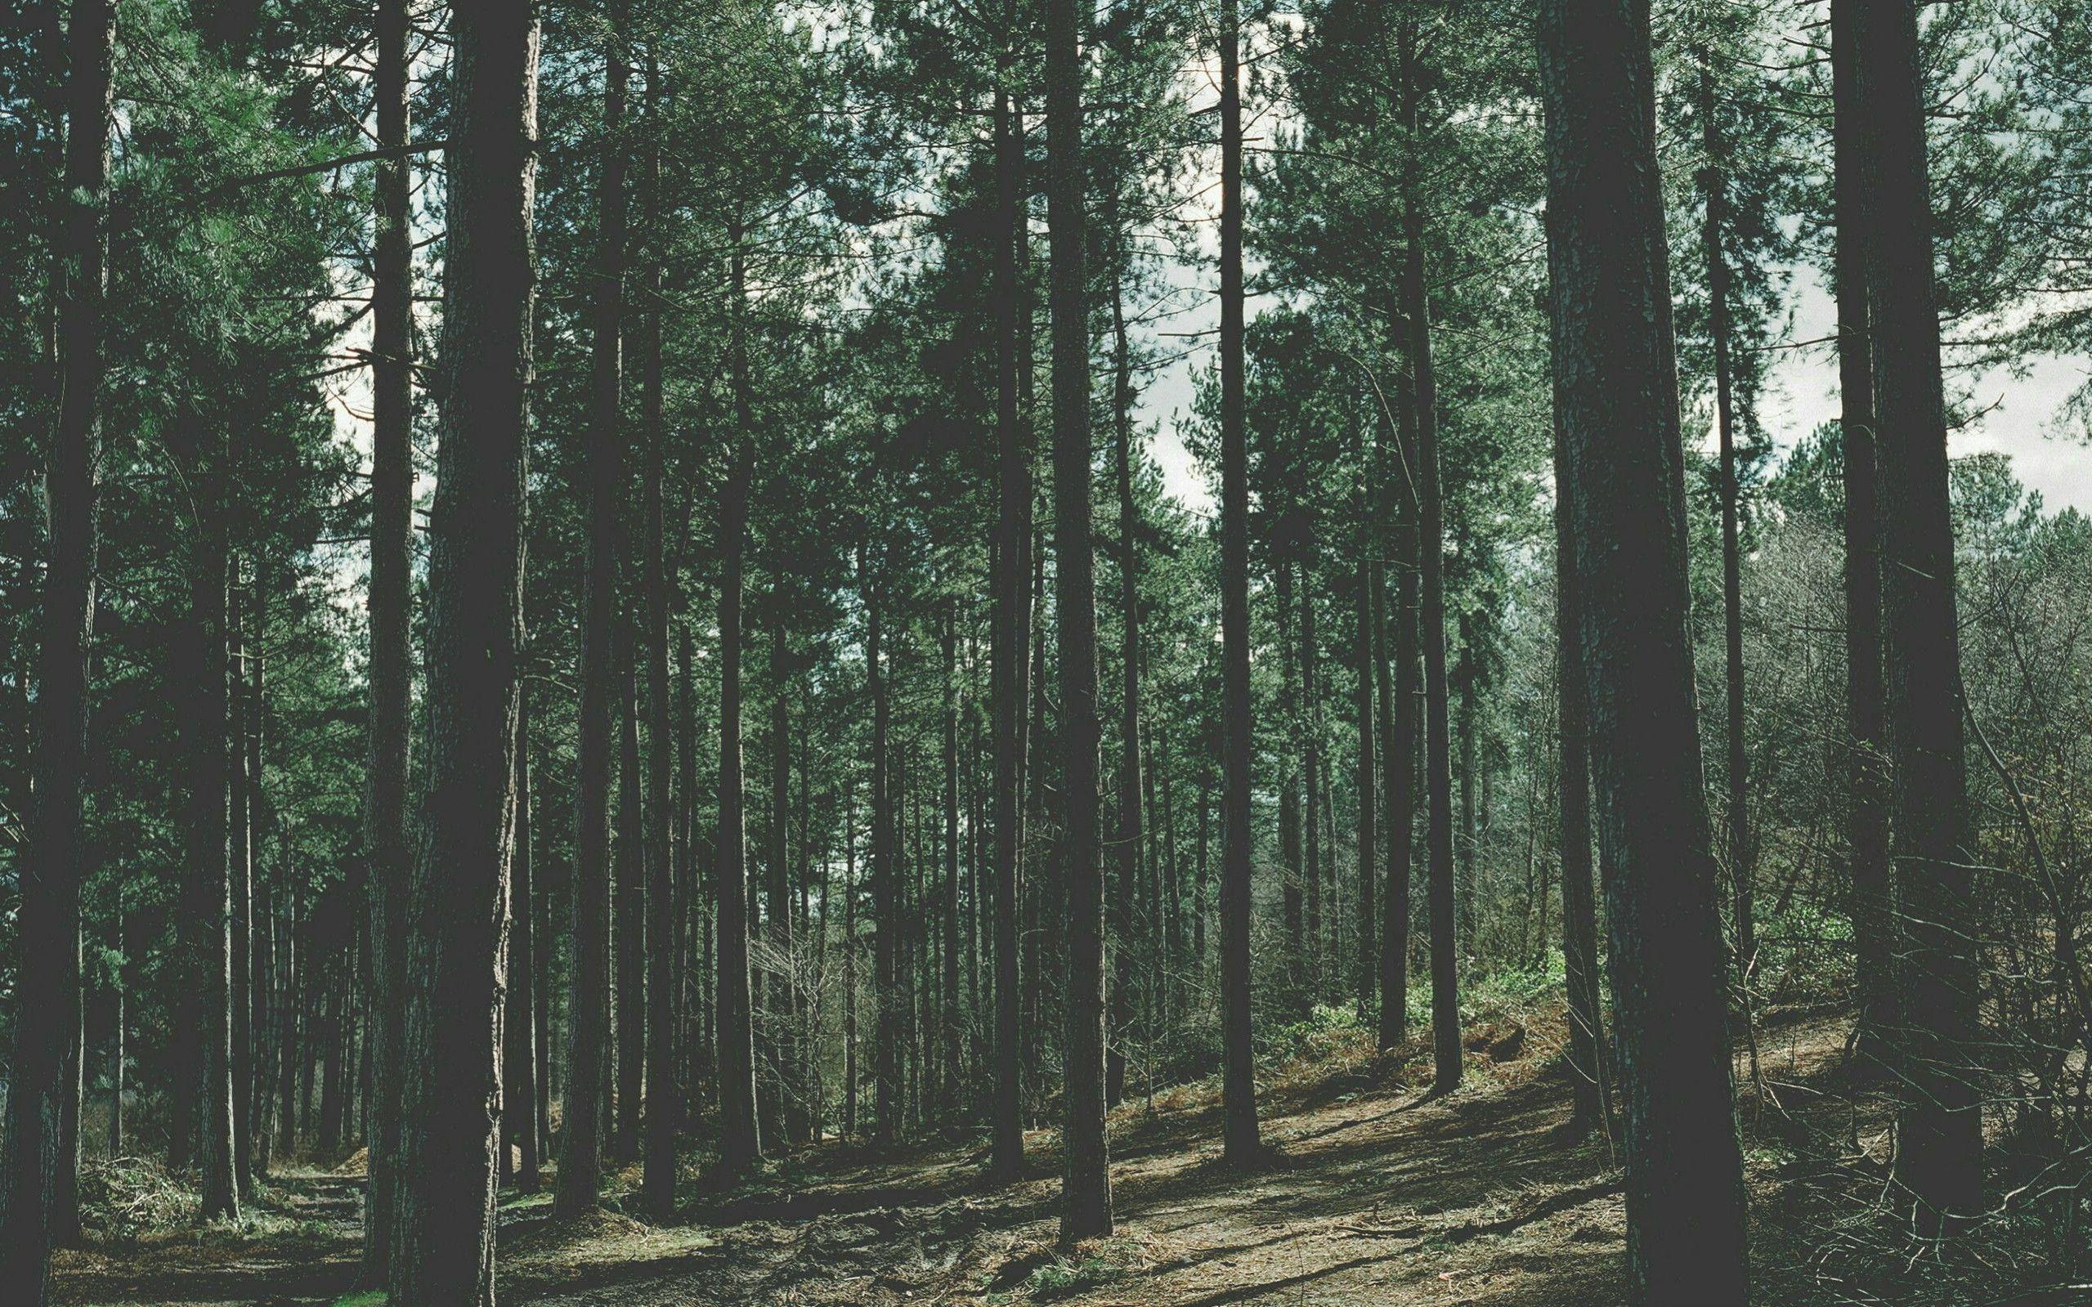
“… a feature of small stories is precisely their weak narrativity, possessing only eventfulness at their core without any standard structural feature. In this case, the phrase ‘It happened’ is enough to qualify the tweet as a narrative…” (Dawn, 2020, p. 976)
Notes:
Slide 9 – Theorising invisible disability stories

Slide 10
#invisibledisability story
A textual narrative that is characterised by the narrator sharing their experience of invisible disability, rather than the strength of the story’s narrativity.
Notes:
Slide 10 – Theorising invisible disability stories
In this sense, the invisible disability story’s primary function is to validate the invisible disability identity and act as counternarratives as by disrupting normative “ideas about what disability is.” (Rice et al., 2015, p. 520).
Invisible disability stories were found either in the caption or in the visual aspect of the post via overlaid text.

Slide 11
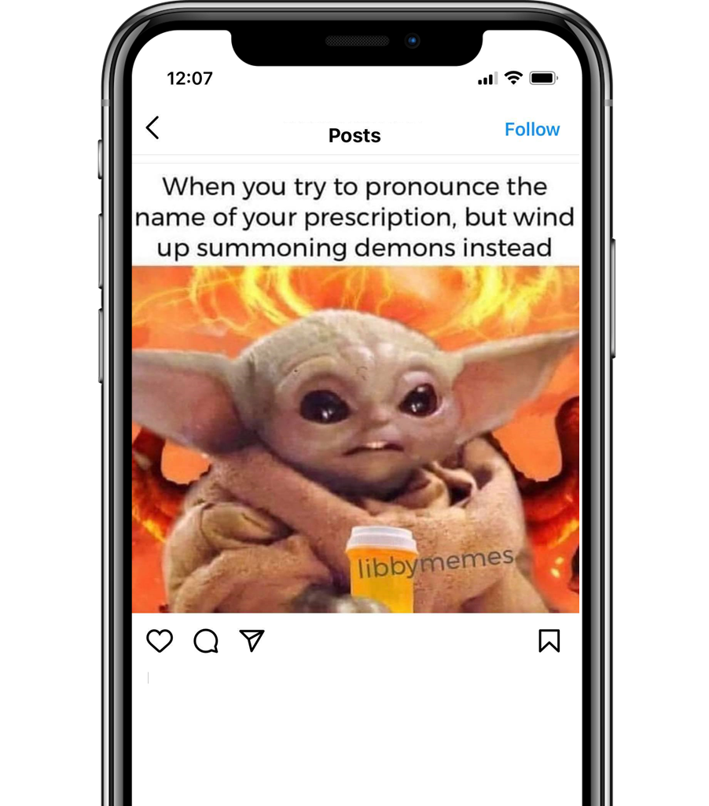
An example of an #invisibledisability story
told via a overlaid text in a meme
Notes:
Slide 11 – Example of an invisible disability story

Slide 12
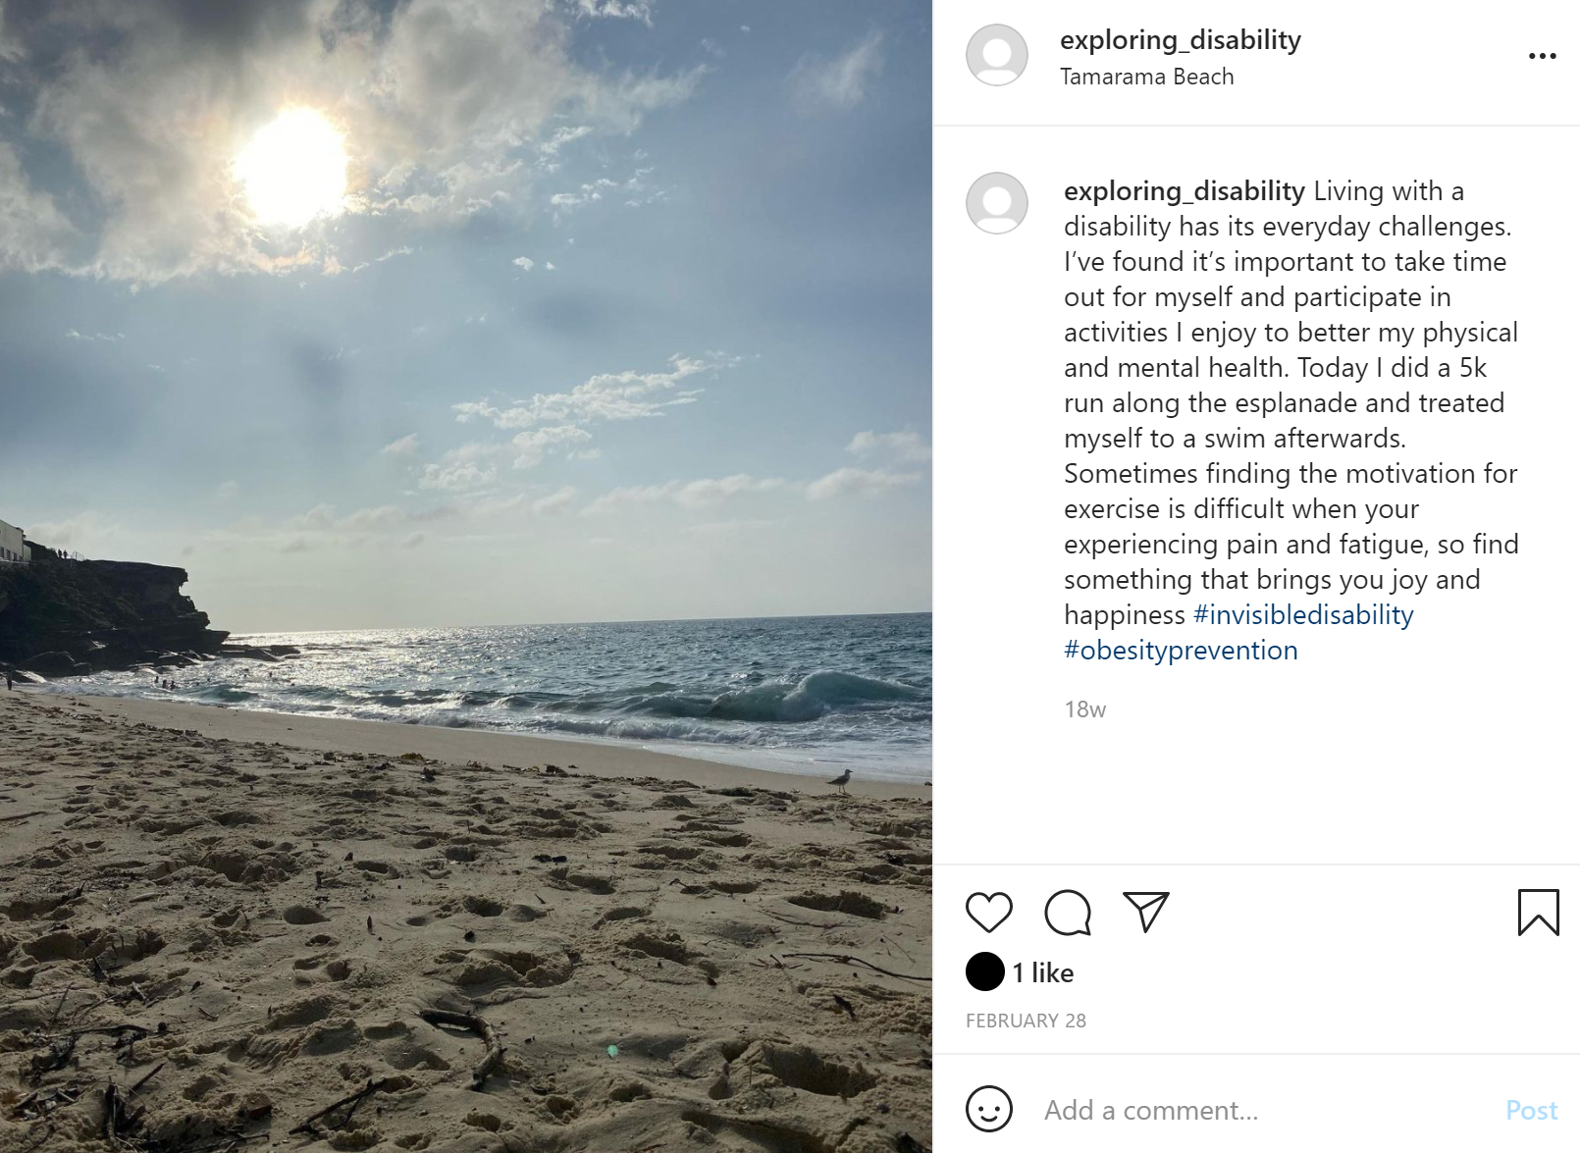
An example of an #invisibledisability
story told in the caption about a user’s experience with pain & fatigue
Notes:
Slide 12 – Example of an invisible disability story
Accordingly, people who use invisible disability stories can be understood to at least belong to the third space of disability activism that Ellis and Goggin (2018, p. 358) describe as a space that largely relies on personal narratives and is “felt by some to be ‘non-political’.”

Slide 13
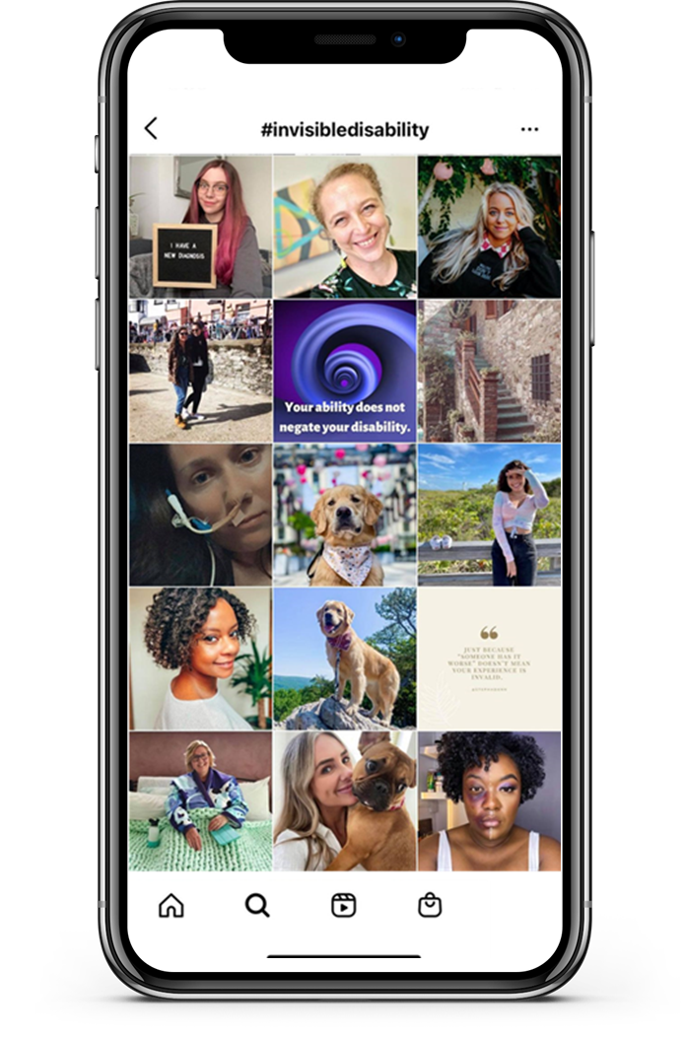
Imagining the archive as an #Invisibledisability story
Notes:
Slide 13 – Archive
If we extend this thinking a little further, we can read the #invisibledisability tag archive as a collection of invisible disability stories which reinforces the invisible disability identity’s legitimacy. So in this way, I think it would be fair to suggest the invisible disability tag has some activist undertones because even if the post isn’t an invisible disability story, as it still contributes to the greater counternarrative that the invisible disability tag archive is fostering.

Slide 14
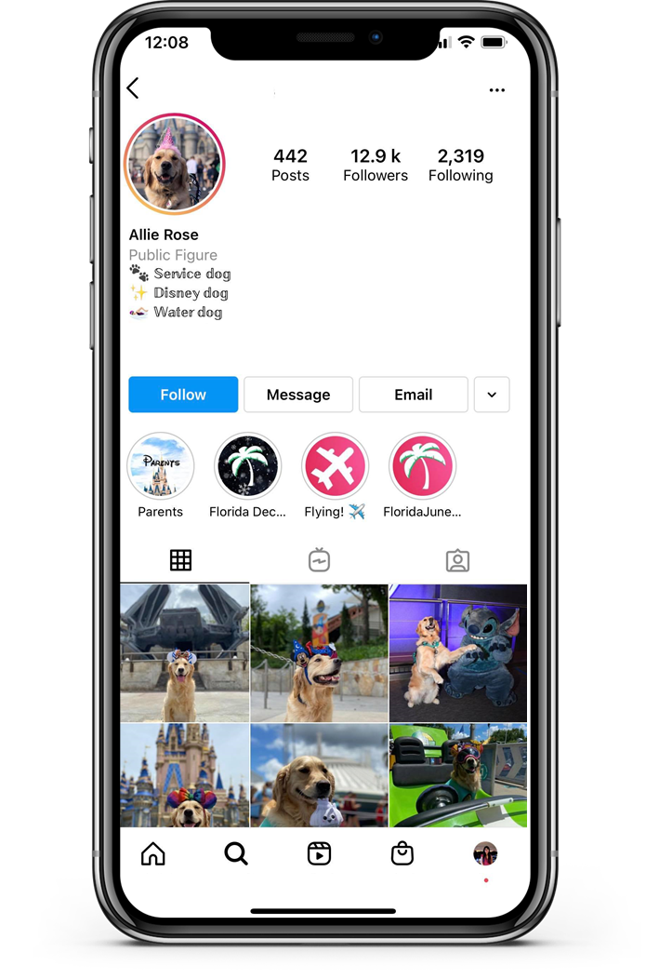
47 disability services and/or
service animal accounts
Tend to use #invisibledisability for visibility among people with invisible disability.
Notes:
Slide 14 – Results

Slide 15
125 invisible disability
48 regular accounts
centric accounts
Account run by someone who happens to have invisible disability.
Tend to use #invisibledisability to share an #invisibledisability story or invisible disability related experience.
25 posts contained an #invisibledisability story
USERNAME
90 usernames implied that the user has an invisible disability.
BIO
115 invisible disability centric accounts implied or stated that the user has an invisible disability in their bio.
More likely to use #invisibledisability in all their posts, however there were 94 #invisibledisability stories
Notes:
Slide 15 – Results

Slide 16
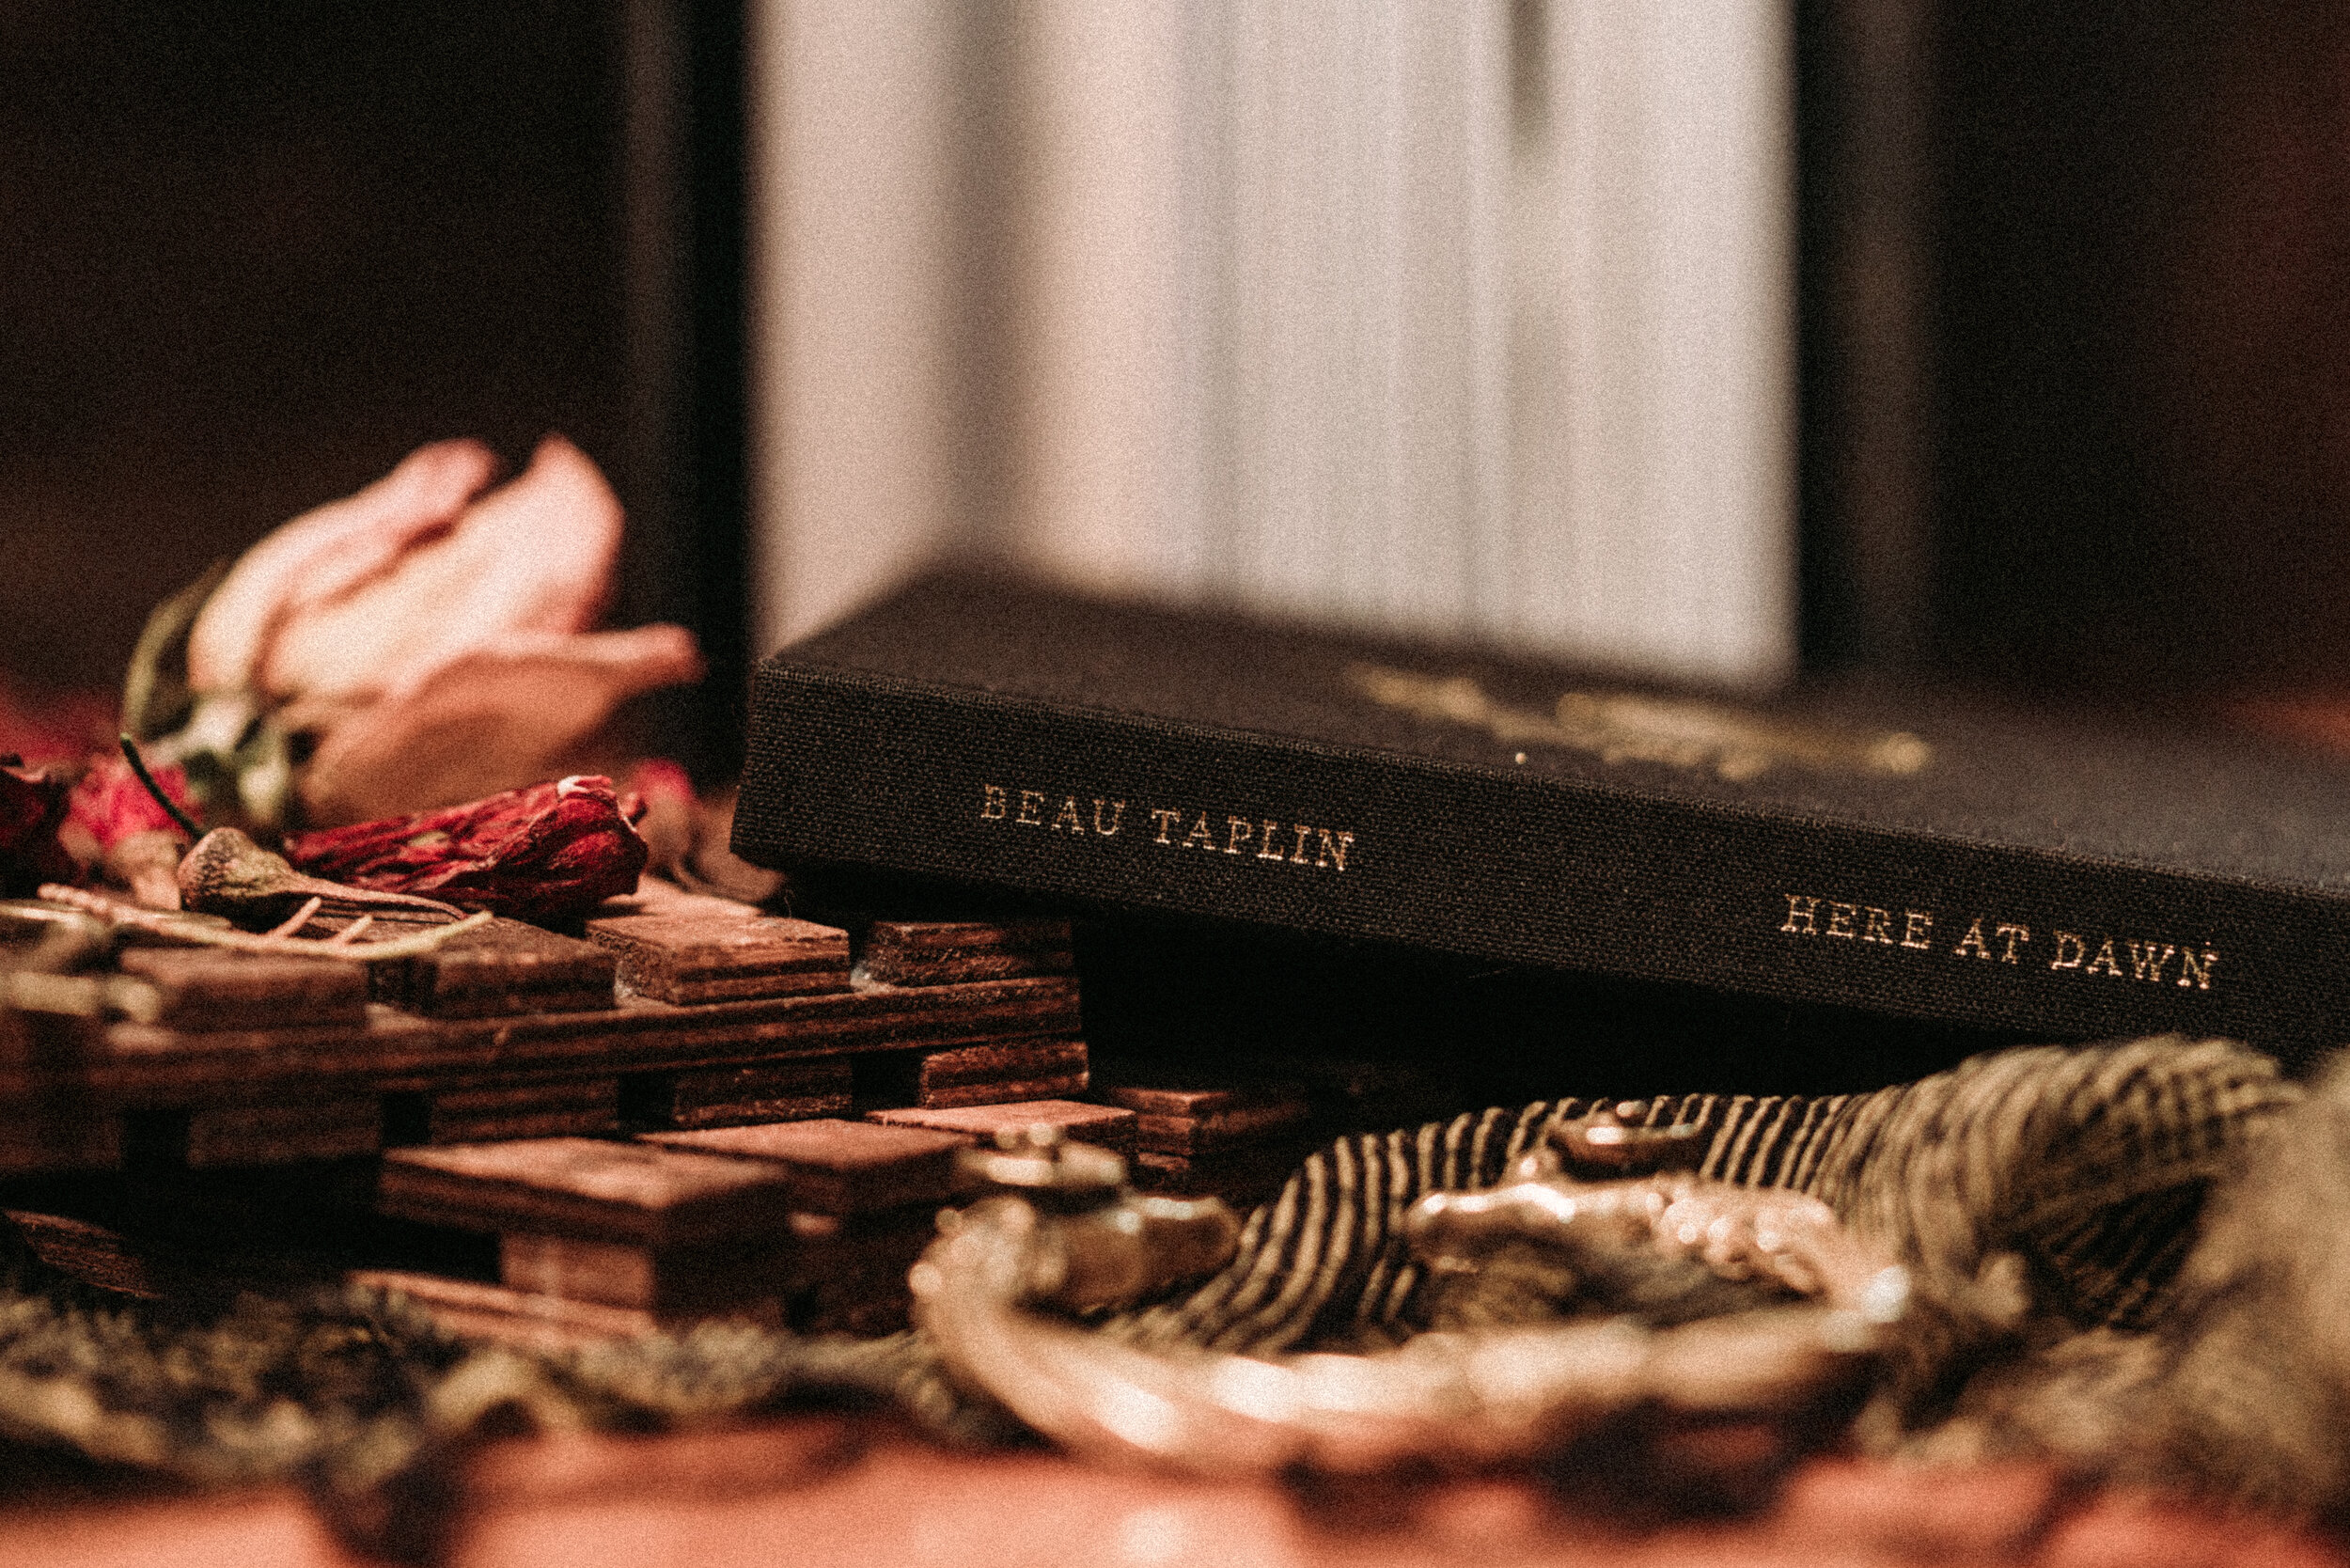
Concluding thoughts
As Herrera (2018, p. 232) contends “identity-based hashtags are not a simple textual representation of identity; rather, they are deployed strategically for specific aims.”
Validation of the invisible disability identity within an imagined community
Raise awareness of the invisible disability identity outside of the imagined community
Potential use in health communications
Notes:
Slide 16 – Conclusion

Slide 17
References
Attitude Foundation. (2018). Invisible disability. Retrieved August 30, 2018, from http://www.attitude.org.au/changing-attitudes/invisible-disability/
Bamberg, M., & Georgakopoulou, A. (2008). Small stories as a new perspective in narrative and identity analysis. Text & Talk, 28(3), 377–396. doi: 10.1515/TEXT.2008.018
Charmaz, K. (2002). Stories and silences: Disclosures and self in chronic illness. Qualitative Inquiry, 8(3), 302–328. doi: 10.1177/107780040200800307
Dawson, P. (2020). Hashtag narrative: Emergent storytelling and affective publics in the digital age. International Journal of Cultural Studies, 23(6), 968–983. doi: 10.1177/1367877920921417
Ellis, K. & Goggin, G. (2014). Disability and social media. In J. Hunsinger, & T. Senft (Eds.). The social media handbook (pp. 126-143). New York, NY: Routledge.
Ellis, K. & Goggin, G. (2018). Disability and media activism. In G. Meikle (Ed.). The Routledge companion to media and activism (pp. 355-364.). London: Routledge.
Eisenhauer, J. (2008). A visual culture of stigma: Critically examining representations of mental illness. Art Education (Reston), 61(5), 13–18. doi: 10.1080/00043125.2008.11518991
Highfield, T., & Leaver, T. (2016). Instagrammatics and digital methods: studying visual social media, from selfies and GIFs to memes and emoji. Communication Research and Practice, 2(1), 47–62. doi: 10.1080/22041451.2016.1155332
Hirschmann, N. (2013). Queer/fear: Disability, sexuality, and the other. The Journal of Medical Humanities, 34(2), 139–147. doi: 10.1007/s10912-013-9208-x
Leaver, T., & Highfield, T. (2018). Visualising the ends of identity: Pre-birth and post-death on Instagram. Information, Communication & Society, 21(1), 30–45. doi: 10.1080/1369118X.2016.1259343
Leaver, T., Highfield, T., & Abidin, C. (2020). Instagram: Visual social media cultures. Polity
Rice, C., Chandler, E., Harrison, E., Liddiard, K., & Ferrari, M. (2015). Project Re-Vision: Disability at the Edges of Representation. Disability & Society, 30(3-4), 513–527. doi: 10.1080/09687599.2015.1037950

